Slide 1
A bit about me and “The Rules”

Slide 2
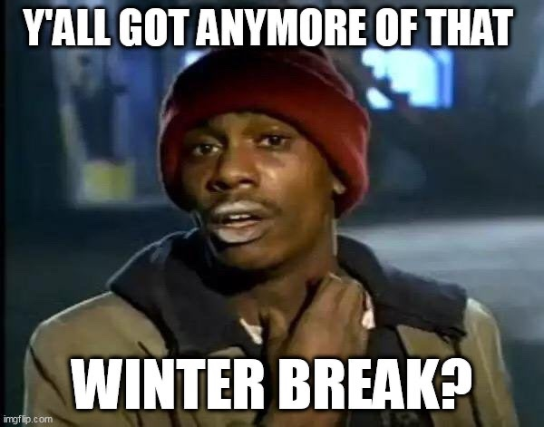

Slide 3
I am…

Slide 4
Professor Michael Phipps
R.I.T. Undergrad (1997)
UAlbany Master’s (2018)
Open Source Contributor
Teaching this class
PhD student

Slide 5
Industry Experience
Software Developer (1997-1998) – Telecom Industry
Senior Software Developer (1998-2003) – Telecom Industry
Small Business Owner (2003-2005) – Health Care
Engineering Manager (2005-2007) – Email (B2B) Industry
5th employee at a startup (2007-2008) – Platform as a Service
iOS Consulting (2008-2009) – Mobile Apps
Developer/DBA (2009-2010) – Health Care
Senior Software Engineer (2010-2015) – Automotive Industry
Software Architect (2015-2017) – Insurance Industry

Slide 6
Whenever I have to do something that I don’t want to do, I try to do that first, then I can look forward to the rest of the project

Slide 7
Academic Dishonesty

Slide 8
What is academic dishonesty?
Claiming other people’s work as your own
Getting answers for a quiz/test from someone else
Using materials not allowed on a quiz/test
Using code or writing from anyone else without attribution

Slide 9
Don’t. Just don’t.

Slide 10
A story of a SUNY Albany grad…

Slide 11
It’s bad for you
It’s bad for the school
It’s not fair to others
It proves nothing

Slide 12
Hello Prof. Phipps,
Hi, I'm not sure if you remember who I am, but my name is XXXXXX. I used to be in your class for ICSI 333 and ICSI 404. I finally have been able to graduate and receive my bachelor's in computer science. I just wanted to say thank you for not being an easy teacher, I guess.
When I began computer science, I didn't really know what I was doing and decided to just follow my friends' footsteps and just cheat on projects to just get on by. But during ICSI 333, you caught me cheating on the XXXXXXX project and told me something that really stuck to me. You told me "I'm spending money for this education to get a good job in the future and if you just cheat, you wouldn't be learning anything and just wasting money and not be able to land any jobs." I realized then that I didn't want to be like my friends who either just dropped out or changed their major to IT because I had a dream to create video games, but at the time I thought it was impossible or for geniuses.
But since you were stern on me and made me re-do my entire project, I had to pick up CSI textbooks, watch YouTube videos and read, learn, and most importantly practice my coding abilities. That has helped me out so much that although right now I don't have a job yet, I could confidently say I know what I'm doing when coding. The code which used to look like alien hieroglyphics now look like English to me.
Since then, I've became more proficient at Java, C# when you tasked my group in (project) for ICSI 499, python and learning SQL, JavaScript and even now learning C++ isn't even a problem, I mean pointers are still whooping my butt but since they kind of remind me of a list or a memory address pointing to memory, it's been getting a bit easier. I now use unity to learn GameDev and might pick up the unreal engine real soon.

Slide 13
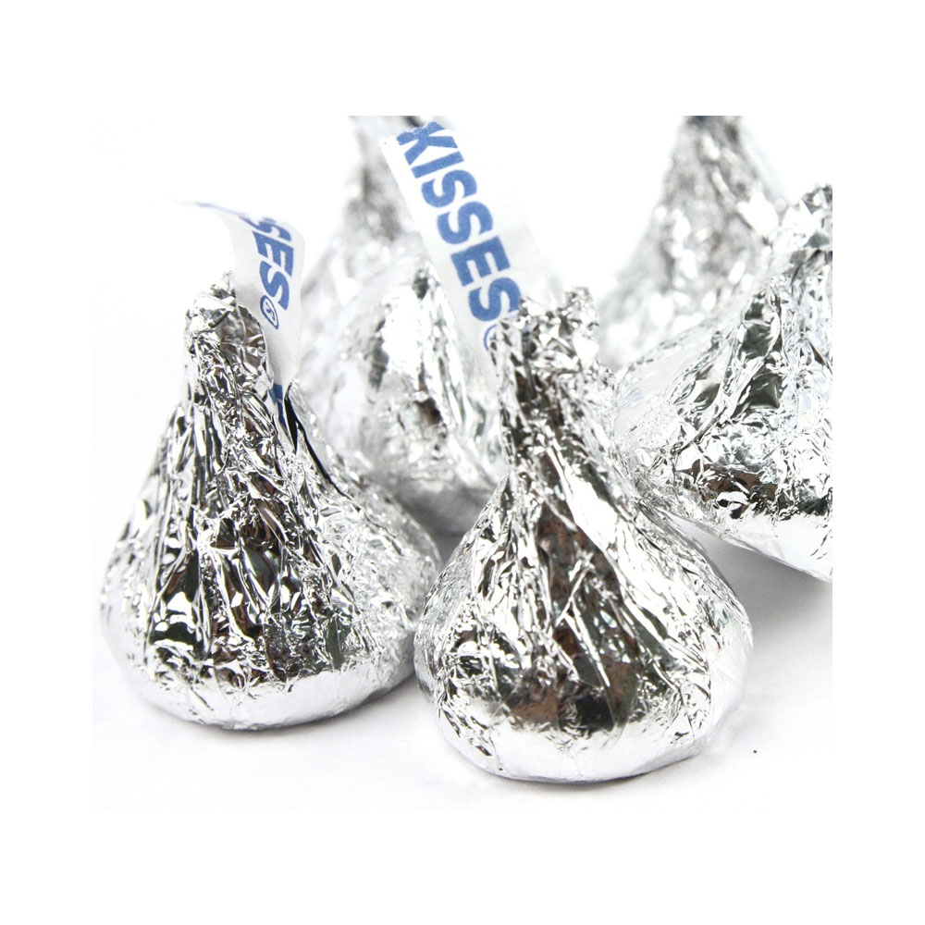
In Class
You must act respectfully toward each other (and me!)
Questions are very welcome in my class. Participation is encouraged!
Don’t just sit and not understand – others probably have the same questions!
Please don’t be distracting to me or to others.
I don’t typically take attendance – it is up to you to come or not.
Coming to class is the biggest single indicator of pass/fail, though.

Slide 14
Email
You can email me anytime. I sometimes get students who apologize for emailing at weird times. Don’t apologize – that’s the best part about email – I read it when I can.
I love talking to students, but email is usually the best way to work.
Please, please, please – sending your code is far better than sending me a screenshot of your code. Screenshots should be your last resort.

Slide 15
Email
I love to get emails from students!
Please put your course in the subject line. “ICSI XXXX – how do I submit”
I WILL ONLY ACCEPT EMAIL FROM YOUR UALBANY EMAIL ADDRESS
Please write clearly. Then read it aloud, to yourself, to make sure that it makes sense. Then send it.
I answer emails at semi-random times; usually within 24 hours you will get an answer, though.

Slide 16
No Late Work
I don’t accept late work, typically. This is actually to HELP you, believe it or not.
Late penalties kill your grade in the class.
Late means less time to work on the next assignment.
START EVERY ASSIGNMENT EARLY!!!

Slide 17
Blackboard will fail you!
It’s 11:55PM and the assignment is due in 5 minutes. You fix the last bugs, test it and it works! Submit it!
Oh, Blackboard is down…
What should you do?
Email a copy of your assignment to me AND the TA(s).
Before the due date.
That (and that ALONE) will prove that you had it done.
I don’t accept dates from your computer, GitHub or anyplace else.

Slide 18
Content of your assignments
You are responsible for the content and timeliness of your submissions.
Submitting the wrong file, file type or version of the file is not a valid reason to be allowed to resubmit.

Slide 19
Disputing a grade
We do a LOT of grading. Sometimes things happen…
If you believe that your grade should be better than it was:
Send an email to the TA(s) and CC me.
You must send this within 7 days of getting your grade. No exceptions.
Subject should be: ICSI XXX – Regrade project X (Example: ICSI404 – Regrade Project 2).
In the body of the email, please explain what you think is incorrectly graded.
You must attach:
Your code (as it was in Blackboard)
The filled-out copy of the rubric

Slide 20
Pictures in class
You are more than welcome to take pictures of the board in class.
I prefer that you don’t take pictures of the slides – you have those electronically anyway.
I do ask that you keep people (especially me!) out of your pictures as much as possible. Your classmates haven’t consented to you taking their picture.

Slide 21
Recording Class
Some people like to make audio recordings of class. I am OK with that. If you want to put your recording device up front, I am OK with that, too. I do walk around a lot, though.
In the past, I have had students who have hearing difficulty and need me to wear a microphone. I would be glad to.

Slide 22
Coming in Late To Class
You have options. You could be doing anything else. You choose to come to class. I am, honestly, honored by that.
Don’t worry about being late. Just come when you can.
Please try not to be disruptive when you come in.

Slide 23
Getting behind and catching up
Most of my assignments build on previous assignments.
Try your best not to get behind.
It is possible to catch up. But it is not easy.
If you get behind, your grades suffer, and you still have to do the work.
It is by far better to stay caught up.

Slide 24
Pre-requisites
The Computer Science department works really hard to assign pre-requisites for each course.
If you haven’t met the pre-requisites, you will be dropped from the course.
We have been asked not to issue permission numbers to circumvent that. Unless you have a really good story, you shouldn’t even try – the whole point is that you have the background to succeed in the class.

Slide 25
Top 10 ways to fail this (or any) class
Stay up the night before the final and cram

Slide 26
Top 10 ways to fail this (or any) class
Don’t talk to the professor – he is a jerk
Stay up the night before the final and cram

Slide 27
Top 10 ways to fail this (or any) class
“Did you finish the assignment? Cool – send it to me…”
Don’t talk to the professor – he is a jerk
Stay up the night before the final and cram

Slide 28
Top 10 ways to fail this (or any) class
I’ll just turn it in late, he’ll take it
“Did you finish the assignment? Cool – send it to me…”
Don’t talk to the professor – he is a jerk
Stay up the night before the final and cram

Slide 29
Top 10 ways to fail this (or any) class
I didn’t even OPEN the book
I’ll just turn it in late, he’ll take it
“Did you finish the assignment? Cool – send it to me…”
Don’t talk to the professor – he is a jerk
Stay up the night before the final and cram

Slide 30
Top 10 ways to fail this (or any) class
Labs are only for Physics class
I didn’t even OPEN the book
I’ll just turn it in late, he’ll take it
“Did you finish the assignment? Cool – send it to me…”
Don’t talk to the professor – he is a jerk
Stay up the night before the final and cram

Slide 31
Top 10 ways to fail this (or any) class
Assignments – they are optional, right?
Labs are only for Physics class
I didn’t even OPEN the book
I’ll just turn it in late, he’ll take it
“Did you finish the assignment? Cool – send it to me…”
Don’t talk to the professor – he is a jerk
Stay up the night before the final and cram

Slide 32
Top 10 ways to fail this (or any) class
I found this cool website called chegg
Assignments – they are optional, right?
Labs are only for Physics class
I didn’t even OPEN the book
I’ll just turn it in late, he’ll take it
“Did you finish the assignment? Cool – send it to me…”
Don’t talk to the professor – he is a jerk
Stay up the night before the final and cram

Slide 33
Top 10 ways to fail this (or any) class
Don’t come to class
I found this cool website called chegg
Assignments – they are optional, right?
Labs are only for Physics class
I didn’t even OPEN the book
I’ll just turn it in late, he’ll take it
“Did you finish the assignment? Cool – send it to me…”
Don’t talk to the professor – he is a jerk
Stay up the night before the final and cram

Slide 34
Top 10 ways to fail this (or any) class
I started playing this game called FortCraft…
Don’t come to class
I found this cool website called chegg
Assignments – they are optional, right?
Labs are only for Physics class
I didn’t even OPEN the book
I’ll just turn it in late, he’ll take it
“Did you finish the assignment? Cool – send it to me…”
Don’t talk to the professor – he is a jerk
Stay up the night before the final and cram

